Slide 1



Arduino Based Third Eye for blind people Solution for the visually impaired
Presented By,
1.Gayatri Choudhari
2.Swaroop Gawali
3.Aniket Gund
4.Maheshwari Gurav

Slide 2
Problems
Due to Transportation
1. Transportation and They may need to rely on guide dogs, canes, or the assistance of others to navigate safely.
3. Blind people may be at a higher risk of accidents or injury, particularly when navigating unfamiliar or hazardous environments.
Limited Accessibility
2. Thelimited accessibility to activities and information, particularly if it is not available in a format that is accessible to them, such as braille or audio recordings.
4. Blind people may have difficulty navigating unfamiliar environments, such as public spaces or buildings, which may not be designed with accessibility in mind.

Slide 3
Solutions
1. Object Detection :
The smart cane could be equipped with sensors that detect obstacles in the user's path, alerting them through vibrations or sounds.
2. GPS and navigation:
The smart cane could use GPS and other navigation technologies to help the user navigate to their desired destination, providing turn-by-turn directions through audio or haptic feedback
3. Fall detection:
The smart cane could be equipped with sensors that detect when the user falls, alerting emergency services or a designated contact..

Slide 4

Aim of the project
01.
The third eye is designed to act as an extension of the blind person's senses, providing them with a better understanding of their surroundings
02.
Arduino -based third eye for blind people is to provide them with a tool that can enhance their ability to navigate their environment and improve their overall quality of life
03.
The third eye aims to be easy to use and customizable, so that it can be adapted to suit the needs and preferences of different users to improve the quality of life for visually impaired individuals, by enhancing their mobility and enabling them to participate more fully in daily activities.
Tool 1
Presentations are tools that can be used as demonstrations, lectures, speeches, reports, and more.

Slide 5
Objective
1.Object detection :
The device should be able to detect obstacles in the path of a blind person and alert them to avoid collisions.
2.Navigation assistance :
The third eye should be able to provide navigation assistance to the user, such as indicating the direction of a destination or guiding them to a specific location.
3.Obstacle avoidance :
The third eye should be able to estimate the distance between the user and obstacles, as well as the distance to their destination.
4. Low-cost and Portable:
The device should be affordable for the target market, and be able to be built using inexpensive components.

Slide 6
Literature Survey
Sl.– No. | Title of the paper | Description | Author | Limitation
1. | Smart walking stick for blind people. | In this paper they have design a smart stick for blind people in which they used raspberry PI as the main architecture with the different sensors and buzzer for alerting the user | Sathya S.Nithyaroopa P.Betty G.Santhoshni S.Sabharinath. Computer science and engeneering, Kumara guru collage of technology | In this paper they have use buzzer which is not so much listenable.
2. | Smart walking stick for visually impaired people. | In this paper they have design a smart stick for blind people in which they have use different sensors like temperature sensor and humidity sensors. | Jayakumar, S.Magesh ,K.Prasanth, P.Umamaheswari, R.Senthilkumar Dept.of EEE, ErodeSengunthar Engineering College. | In this paper there is no mechanism to locate the stick if it is misplaced.
3. | Smart walking stick For visually impaired person. | n this paper they have design a stick forthe blind people using Arduino Atmega 328 which was impacted with ultrasonic sensor for detecting the obstacles. | Dada Emmanuel GbengaArhyel Ibrahim Shani Adebimpe Lateef Adekunle . Department of computer science University of malaya | In this paper there is no mechanism for sensing the water in the way of the user
4. | Smart stick for blind people | In this paper they have Design a smart stick for blind people using microcontroller and impacted with different sensors and GPS for the user convinence. | D.Sekar,S.SivakumarP.Thiyagarajan, R. Premkumar, M. Vivekkumar UG Student, Eshwar College of Engineering . | In this paper there is no mechanism for walking in night to indicate the other people about the blind person.

Slide 7
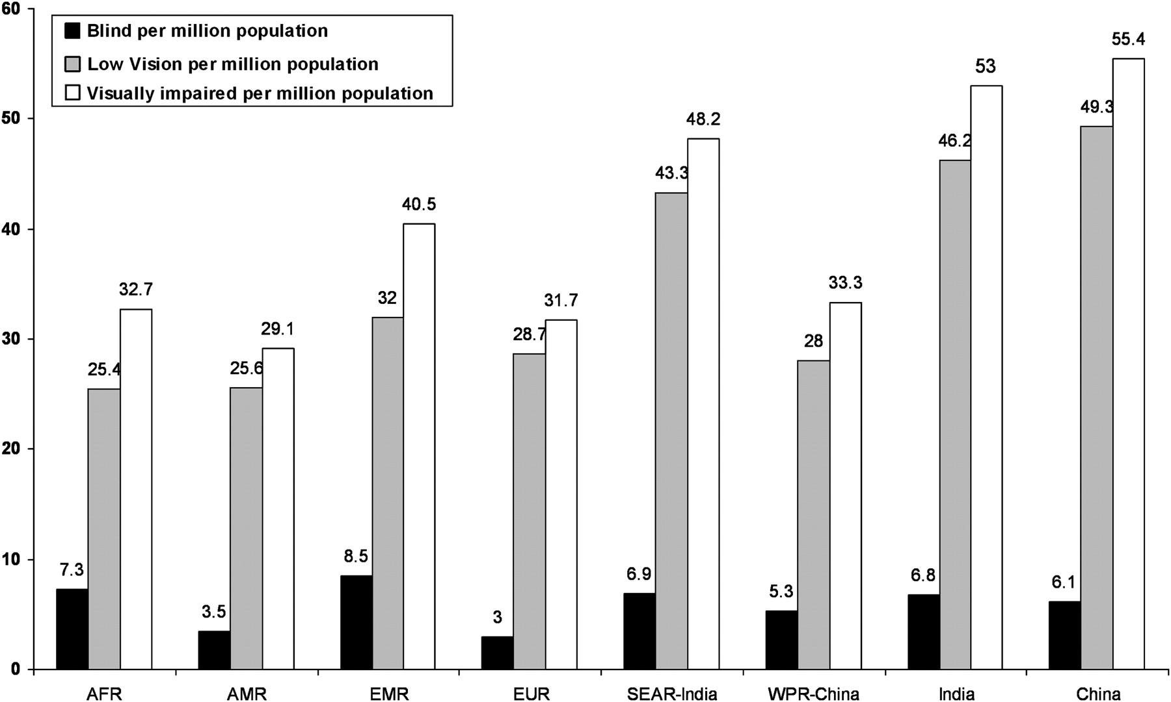
World Health Organization Estimation of 2011
285 Million
01. People with visual impairment:
285 Million
39 Billion
02. Blind people:
39 Billion
03. People with low vision :-
246 Billion
Reference Link :
https://www.who.int/news-room/fact-sheets/detail/blindness-and-visual-impairment

Slide 8
Scope
1.
Increased independence
2.
Enhanced spatial awareness and Improved quality of life
3.
Potential for future development
The device can provide users with information about their surroundings, such as the location of objects and the distance to nearby obstacles. By providing visually impaired individuals with greater independence and the ability to navigate their surroundings more easily, the third eye can improve their overall quality of life..
With the help of the Arduino -based third eye, visually impaired individuals may be able to navigate unfamiliar places with greater ease, reducing their reliance on others for assistance. Improved safety: The third eye can detect obstacles and alert the user to potential hazards, helping them to avoid accidents..
The Arduino-based third eye project could serve as a starting point for future research and development in the field of assistive technology, leading to the creation of even more sophisticated devices to help visually impaired individuals.

Slide 9
Motivation
1.
Arduino - based third eye for blind people is to provide them with a tool that can enhance their ability to navigate their environment and improve their overall quality of life.
The third eye is designed to act as an extension of the blind person's senses, providing them with a better understanding of their surroundings.
2.
Blindness is a challenging condition that affects millions of people worldwide, and it can severely limit their ability to perform daily tasks independently.
3.
The third eye is designed to act as an extension of the blind person's senses, providing them with a better understanding of their surroundings.
4.
This feedback allows the user to perceive the distance and location of objects in their environment, making it easier for them to navigate their surroundings safely . By creating an affordable and accessible device that can assist blind people in their daily lives, the project aims to improve their independence, mobility, and overall quality of life.

Slide 10
The Problem
Components :
The Problem
Sr No | Component Name | Specifications
1. | Arduino Uno R3 | ATMega328P Processor Memory AVR CPU at up to 16 MHz 32KB Flash 2KB SRAM 1KB EEPROM | Security Power On Reset (POR) Brown Out Detection (BOD) Power 2.7-5.5 volts
2. | Ultrasonic Sensor | Power Supply: DC 5V Working Current: 15mA Working Frequency: 40Hz Ranging Distance : 2cm – 400cm/4m | Resolution : 0.3 cm Measuring Angle: 15 degree Trigger Input Pulse width: 10uS Dimension: 45mm x 20mm x 15mm
3. | Vibrator Motor | Size:11.6 × 4.6 × 4.8 mm¹ Weight:0.8 g² | No-load speed @ 3V:12500 rpm No-load current @ 3V:65 mA³ Stall current @ 3V:100 mA Voltage:3 V⁴
4. | Piezo Buzzer | Operating voltage of ~1.5 to ~30 V –Typical current consumption of up to ~100 mA or more | -Approximate resonant frequencies of 1 to 3 kHz
5. | Lithium ion Battery | 2 batteries
6. | Jumper Wires | 1 male and 1 female
7. | Stick | 1
1.5M
80%
Indians die due to poor healthcare
Indians cite lack of care at healthcare units

Slide 11
Components Specification
Ultrasonic Sensor :
The HC-SR04 Ultrasonic Distance Sensor is a sensor used for detecting the distance to an object using sonar).
Arduino UNO (The Arduino UNO is an open-source microcontroller board based on the Microchip ATmega328P microcontroller and developed by Arduinocc . The board is equipped with sets of digital and analog input/output pins).
Piezo Buzzer
(A piezo buzzer is basically a tiny speaker that you can connect directly to an Arduino; from the arduino you can make sounds with a buzzer by using tone).

Slide 12
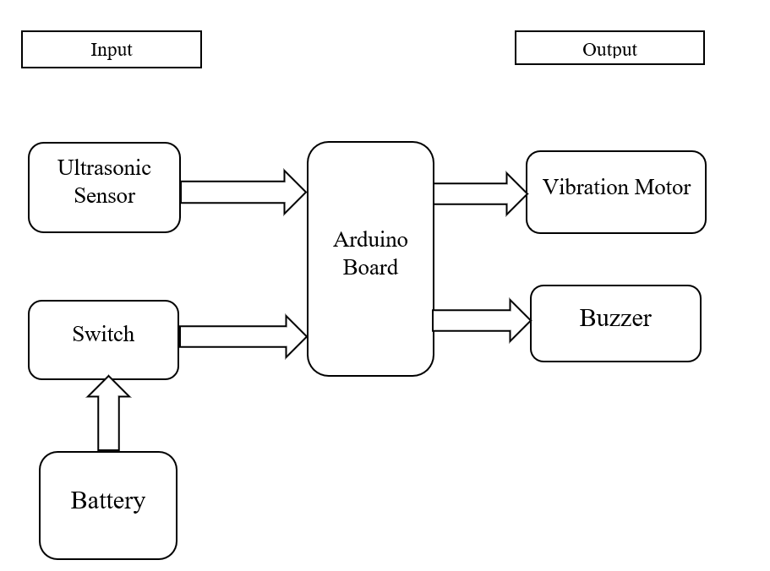
Block Diagram

Slide 13
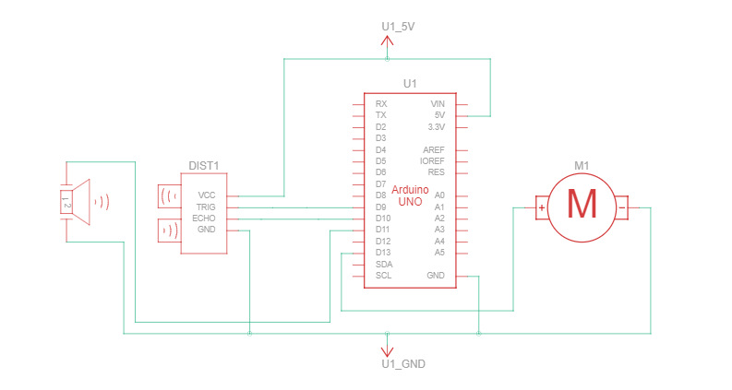
Circuit Diagram

Slide 14
Working :
01
connected 9 volt battery for the power supply which provides power to arduino
02
03
Arduino Uno send a signal to the Buzzer and vibrator motor. vibrator motor and buzzer get vibrate and buzzed
04
Then respected user (the blind person) will easily manage his work with safety
Arduino Uno distributes the power to all components Also we will connect a ultrasonic sensor in the circuit to detect obstacles which will send the signal to the Arduino Uno

Slide 15
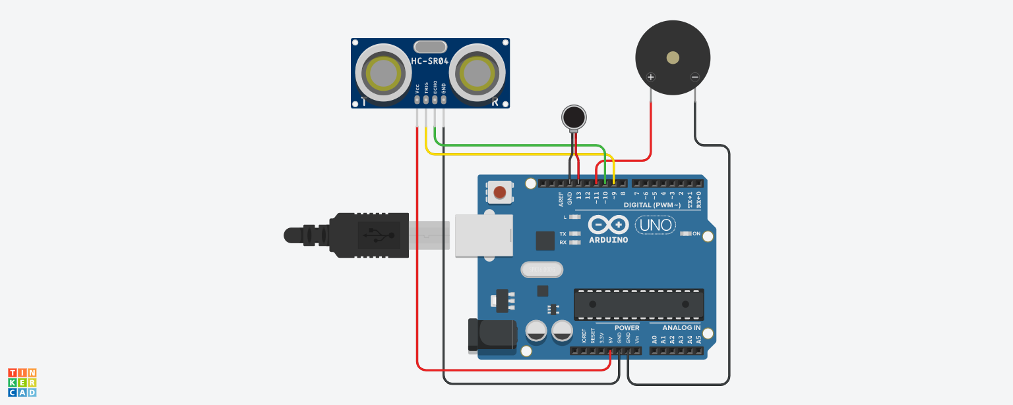
Schematic Diagram

Slide 16
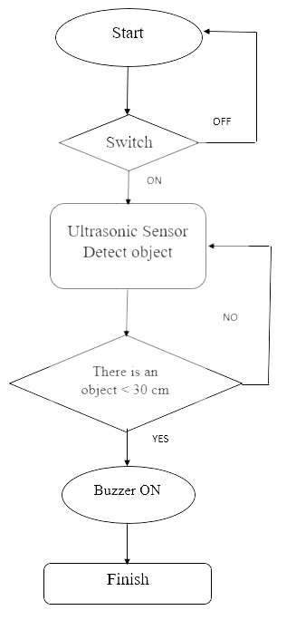
Flow Chart

Slide 17
Code For Aurdino based third eye for blind people
// C++ code
//
// defines pins numbers
const int trigPin = 9;
const int echoPin = 10;
const int buzzer = 11;
const int ledPin = 13;
// defines variables
long duration;int distance;
int safetyDistance;
void setup()
{
pinMode(trigPin, OUTPUT);
// Sets the trigPin as an Output
pinMode(echoPin, INPUT);
// Sets the echoPin as an InputpinMode(buzzer, OUTPUT);
pinMode(ledPin, OUTPUT);
Serial.begin(9600);
// Starts the serial communication
}
void loop()
{
// Clears the trigPin
digitalWrite(trigPin, LOW);
delayMicroseconds(2);
// Sets the trig
Pin on HIGH state for 10 micro seconds
digitalWrite(trigPin, HIGH);
delayMicroseconds(10);
digitalWrite(trigPin, LOW);
// Reads the echoPin, returns the sound wave travel time in microsecondsduration = pulseIn(echoPin, HIGH);
// Calculating the distance
distance= duration*0.034/2;
safetyDistance = distance;
if (safetyDistance <= 10)
{
digitalWrite(buzzer, HIGH);
digitalWrite(ledPin, HIGH);
}
Else
{
digitalWrite(buzzer, LOW);
digitalWrite(ledPin, LOW);
}
// Prints the distance on the Serial MonitorSerial.print("Distance: ")
;Serial.println(distance);
}

Slide 18
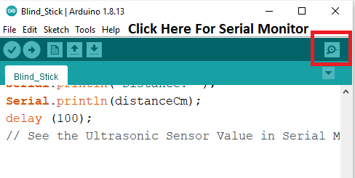
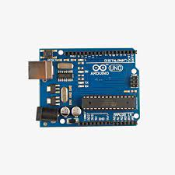
Code Snippets using Arduino
FEATURES
BENEFITS
Obstacle Detection
Navigation assistance
Obstacle Avoidance
Auto Detection

Slide 19
Implementation
01
02
03
very low cost solution to millions of blind person worldwide.
combination of working units makes the system that monitors position of the user and providesl feedback making navigation more safe and secure.
It can be further improved to have more decision taking capabilities by employing varied types of sensors and thus could be used for different applications

Slide 20
Future Scope :-
1. Improving the sensor technology:
AI and Machine Learning:
3. Wireless communication and remote assistance:
4. Improving battery life:
5. Mass production and commercialization:

Slide 21
Reference
Sr No. | Title of the paper | Description | Author
01 | Arduino based navigation system for visually impaired people | Development of Arduino based navigation system for visually impaired people | by H.A. Rijal, S. Thapa, S. Kafle, and S. Baniya.
02 | "Ultrasonic Blind Walking Stick" | This research paper presents a walking stick for visually impaired individuals that uses ultrasonic sensors and Arduino.“ | by N. Arunkumar and R. Sharmila.
03 | “The Third Eye - Arduino Powered Blind Navigation System" | “The Third Eye - Arduino Powered Blind Navigation System" | by J. Jadhav
04 | Arduino Based Obstacle Avoiding Robot" | Arduino Based Obstacle Avoiding Robot | by S. Sonar and P. Muley.

Slide 22

Thankyou

